Slide 1

Introduction to Computer Semaphores
Professor : Jake Tarn
Lecturer: Sunny

Slide 2
Binary Semaphore
xSemaphoreCreateBinary()
SemaphoreHandle_t xSemaphoreCreateBinary( void );
xSemaphoreTake()
BaseType_t xSemaphoreTake (
SemaphoreHandle_t xSemaphore,
TickType_t xTicksToWait
);
Notes:
Creation of a semaphore
xSemaphore: semaphore to be created.
Taking a semaphore
A task taking the semaphore must wait it to be available and is blocked until it is or until a delay is elapsed (if applicable).
xSemaphore is the semaphore to take.
xTicksToWait is the time, in clock ticks, for the task to wait before it gives up with taking the semaphore.

Slide 3
Binary Semaphore
xSemaphoreGive()
BaseType_t xSemaphoreGive ( SemaphoreHandle_t xSemaphore );
xSemaphoreGiveFromISR()
BaseType_t xSemaphoreGiveFromISR (
SemaphoreHandle_t xSemaphore,
BaseType_t * pxHigherPriorityTaskWoken
);
Notes:
Giving a semaphore
Giving a semaphore can be compared to a V() operation or to writing on a queue.
xSemaphore is the semaphore to be given.

Slide 4
Simple Binary Semaphore

Slide 5
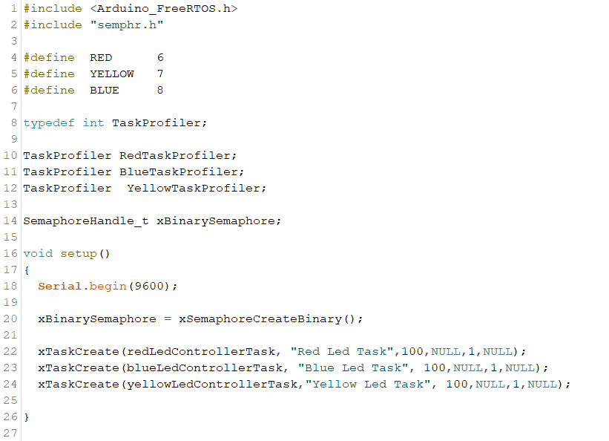

Slide 6
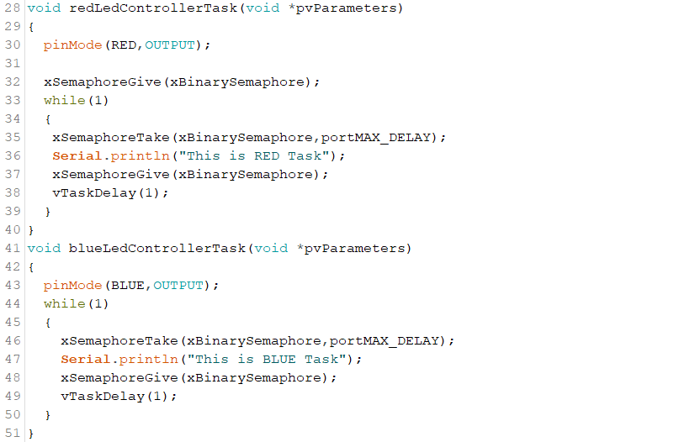

Slide 7
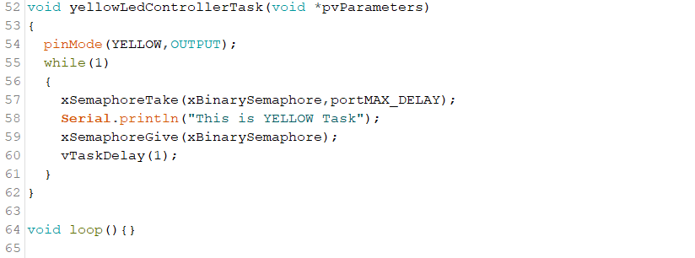

Slide 8
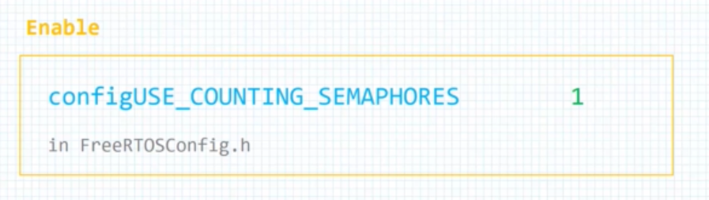
Counting Semaphore
Counting Semaphore

Slide 9

Counting Semaphore

Slide 10
API Function
xSemaphoreCreateCounting()
SemaphoreHandle_t xSemaphoreCreateCounting (
UBaseType_t uxMaxCount,
UBaseType_t uxInitialCount
);
Notes:
uxMaxCount is the capacity of the counting semaphore, its maximum ability to be taken.
uxInitialCount is the new semaphore's availability after it is created.

Slide 11
Counting Semaphore

Slide 12
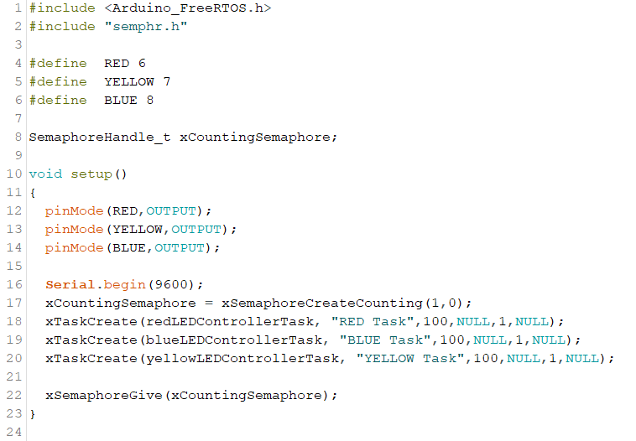

Slide 13
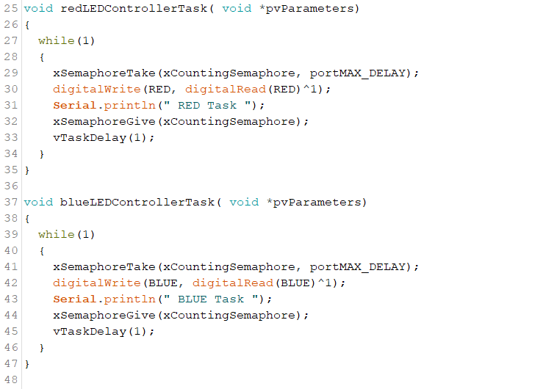

Slide 14
